Slide 1

A presentation on……. Cse : 200
A Presentation on Software Development Project….
Course : CSE-200
…..
Lets start……………………………..

Slide 2
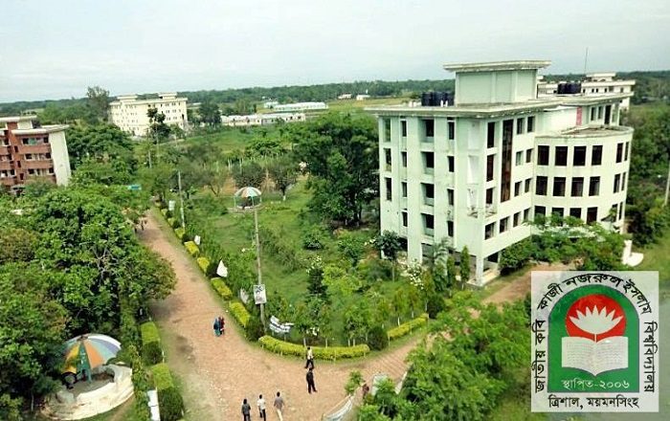
PRESENTATION :
Course : CSE-200.
SESSION : 2016-17.
DEPARTMENT : C.S.E.
Supervised By: Kazi Mahmudul Hassan.
Project Name : Restaurant Management System.

Slide 3
INTRODUCTION :
Name: MD. MONTASIR AMIN.
Roll:17102033
Name: MOSTAFA AHMED AN-NUR
Roll: 17102024

Slide 4
LET’S BEGIN :

Slide 5
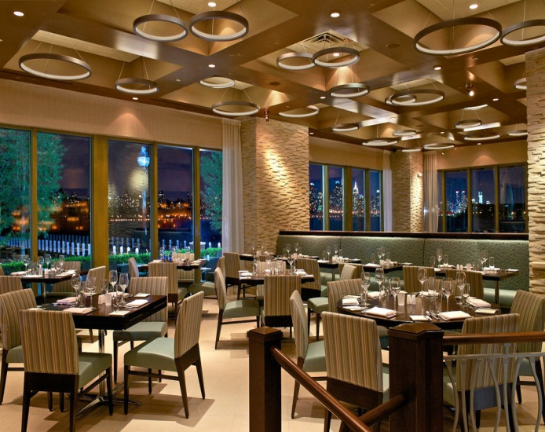
INTRODUCTION :
A restaurant management system is POS software designed for the foodservice industry. Like a standard POS system, restaurant management system helps us capture transactions and manage inventory with accuracy and generally run everyday processes more efficiently. A setup may include both software and hardware, too, like the cash register, barcode scanner, and receipt printer.
FIG 1: A typical Restaurant.

Slide 6
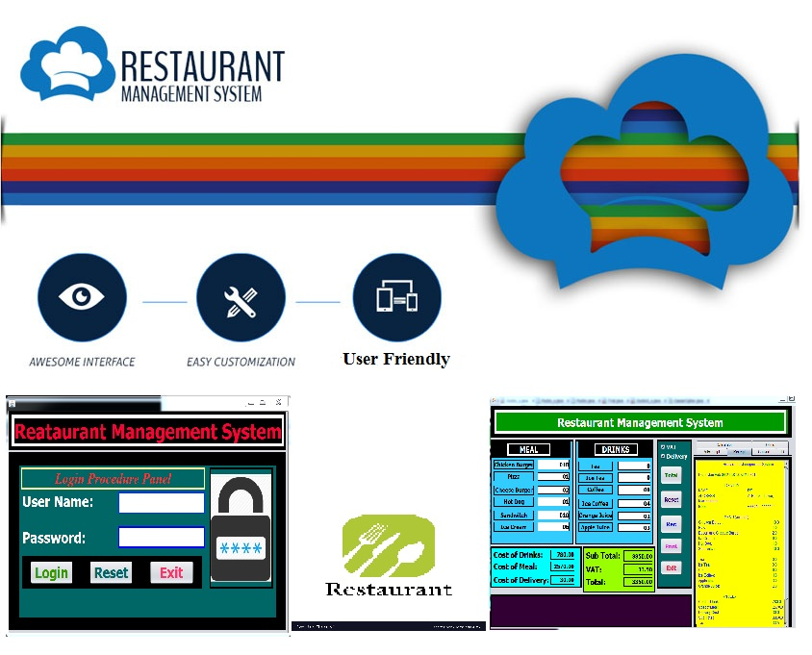
INTRODUCTION :
Restaurant management software is the collective term for software that is used to aid in restaurant operations. This is mainly POS software, but can include other types of software as well. Such software usually assists with ordering, billing, inventory management, and queue management, and can be broadly divided into FOH (front of house) and BOH (back of house) software. Benefits of using software to manage aspects of restaurant operations include efficiency and a reduction in customer wait times, as well as preventing employee scams.

Slide 7
Objectives :
Manually it is very difficult to handle Restaurant Management System manually in individual customer’s relevant information and total cost of the customer counting the total bill along with VAT and delivery charge if necessary. With the help of computer it becomes easy and faster to manage the system. In this project, it is the facilities to take all information and calculate a customer’s total bill calculation in the system. The main objective of the system is which target to put a security to the user of the software and calculate his total bill of food purchasing and also automatically generating a receipt and printing out feature of this along with calculating Restaurants owners monthly Evaluation whether he is in Loss or in Big-profit environment. The extra feature here exists are aided general calculator, currency conversion calculator, automatic date and time feature in the receipt paper and other related things.

Slide 8


Background Study :
Before developing a software like Restaurant Management System, We have to study a little about what is management system in Restaurant sector and the related term in this. Restaurant management system software is the software by which we can easily calculate the total bill along with VAT and delivery charge of a customer. We can also Generate the receipt of bill automatically and further can print out the bill receipt by the help of a printer device. This facility can also be applied in calculating total salary of waiters and others cost in order to get the point whether in a specific month a restaurant has achieved its Big-profit or Loss.
FIG 2(a): Typical Logo of a Restaurant FIG 2(b): Typical Logo of a Restaurant

Slide 9
Keywords :
The keywords related to our projects are as follow:
User Name
Password(Log In)
Name and Address of the Customer
Cost of Meal and Drinks
Delivery Cost
TAX
Data Validation
Total Bill of Customer
Reset all items
Print Customers Bill Receipt
Small General Calculator
Currency Converter
Admins Debit-Credit Calculation
Printable Cash Memo
Printable Authorities Debit-Credit Calculation and Profit
Time and Date
Resetting all items for further use.

Slide 10

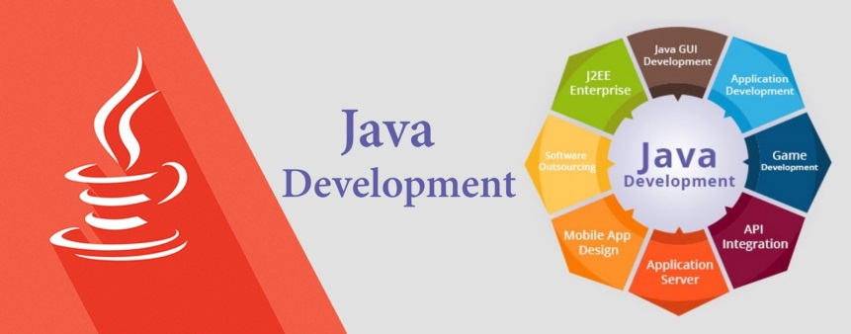
Tools :
We used an IDE named NetBeans v.8.2 to implement, build and operate the code.
We took the help of JAVA language to build our software project.
FIG 5: JAVA language theme FIG 6: JAVA language Symbol

Slide 11

Tools :
FIG 4: NetBeans IDE.

Slide 12
Overview of the Software :
The software we developed here is simple to use. Whenever the authority needs to calculate the customer’s total bill after order they just have to click the software icon. Then the software will ask them the required username and password. If the authority is legal they will enter the correct username and password and can get access to the main function of the software. The software then asks them the amount of each food and drink item. There are options for VAT and also delivery. If clicked delivery button it asks for customers Name, Address and Contact number. After taking all data this program calculates them and shows the total Bill of the customer and when clicking Receipt Button it automatically generates a Bill receipt in a nice formation pattern including current date and time. Finally we get the exact cost that the customer has to pay in the printed Bill Receipt.
Another thing is in Office panel, we can calculate if the owners of the Restaurants have achieved Big-profit or Loss with the print out facility also.
The additional feature of this project is Aided general Calculator, Aided Currency Conversion Calculator and so on.

Slide 13
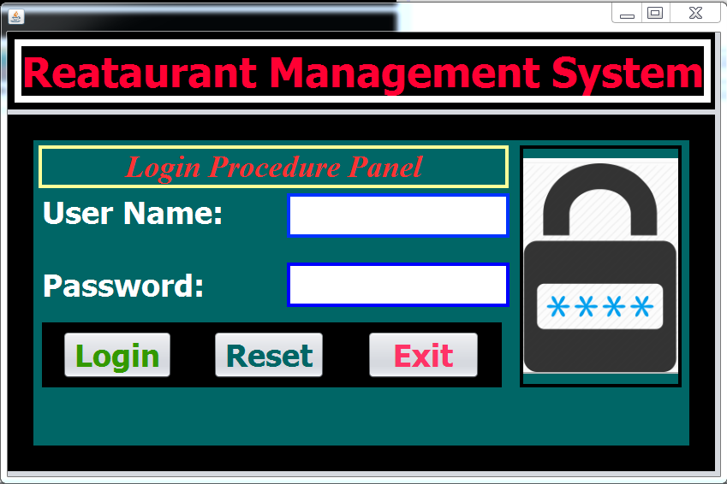
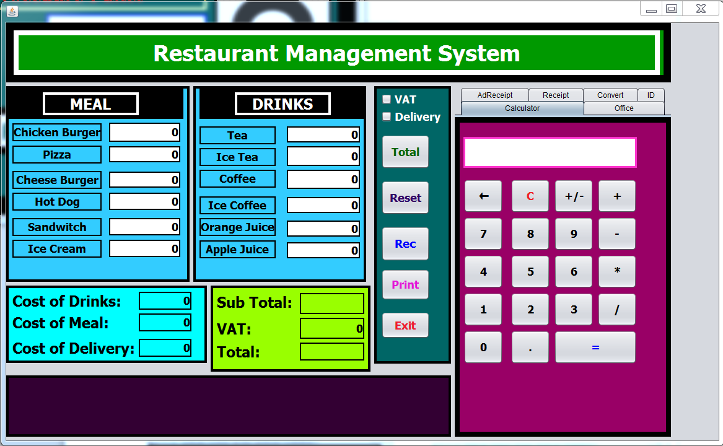
Overview of the Software (screenshots):
screenshot 1 screenshot 2

Slide 14
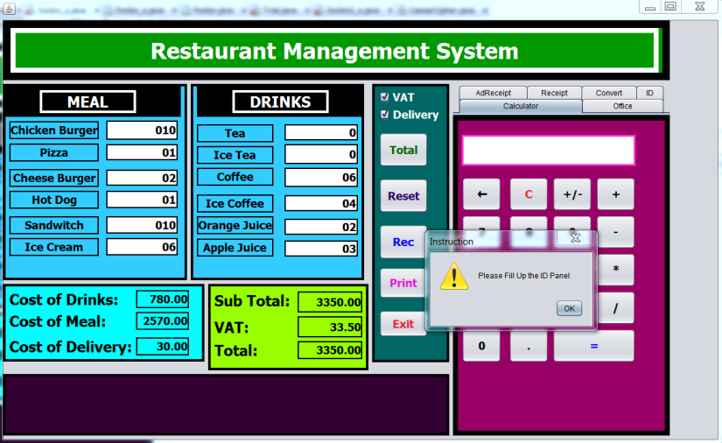
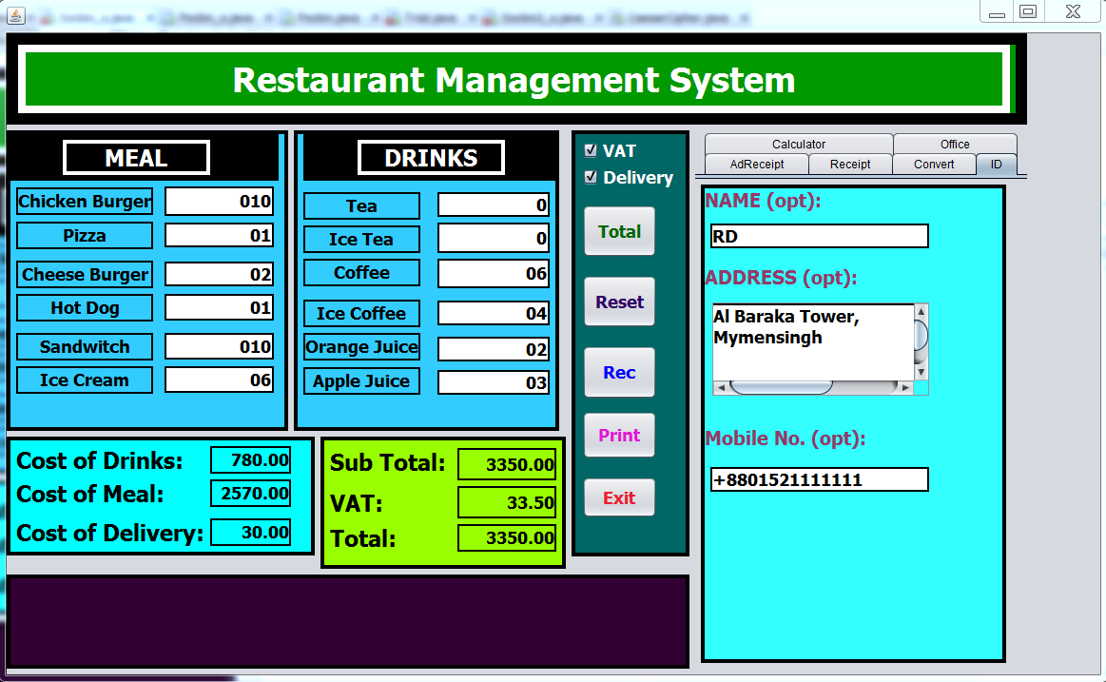
Overview of the Software (screenshots):
screenshot 3 screenshot 4

Slide 15
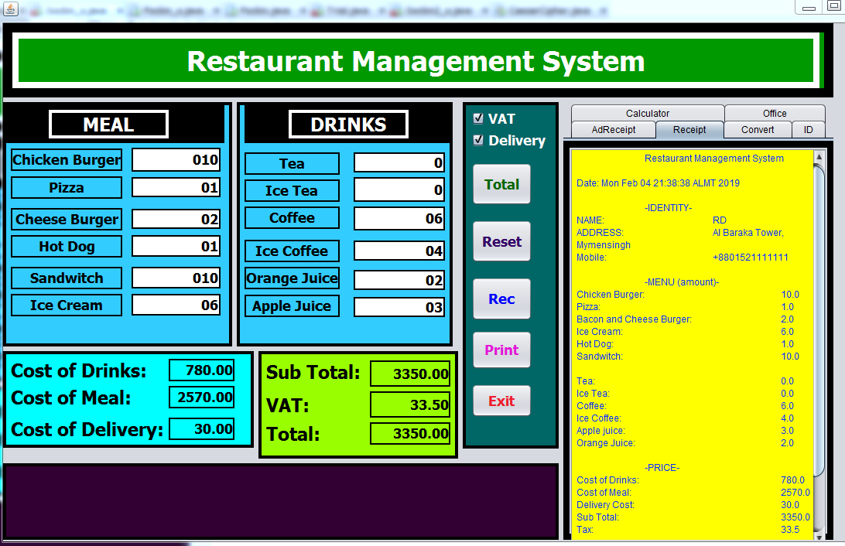
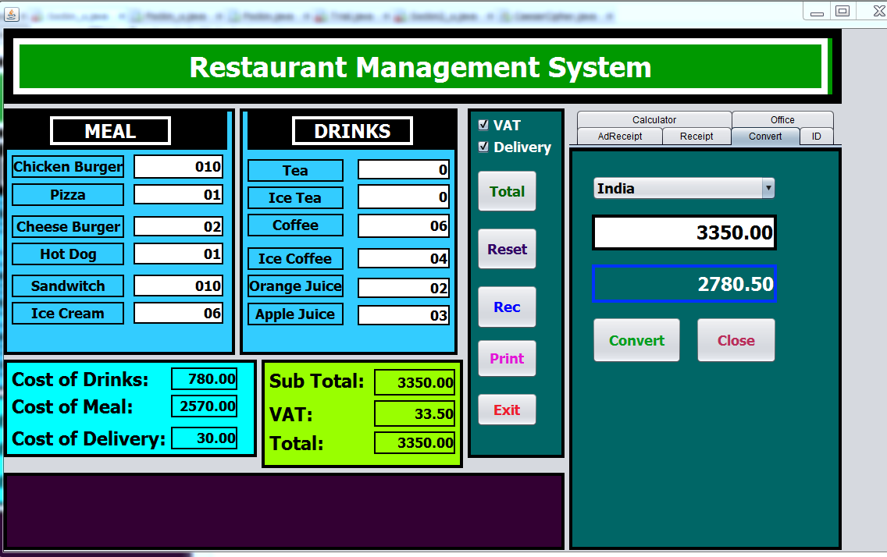
Overview of the Software (screenshots):
screenshot 5 screenshot 6

Slide 16
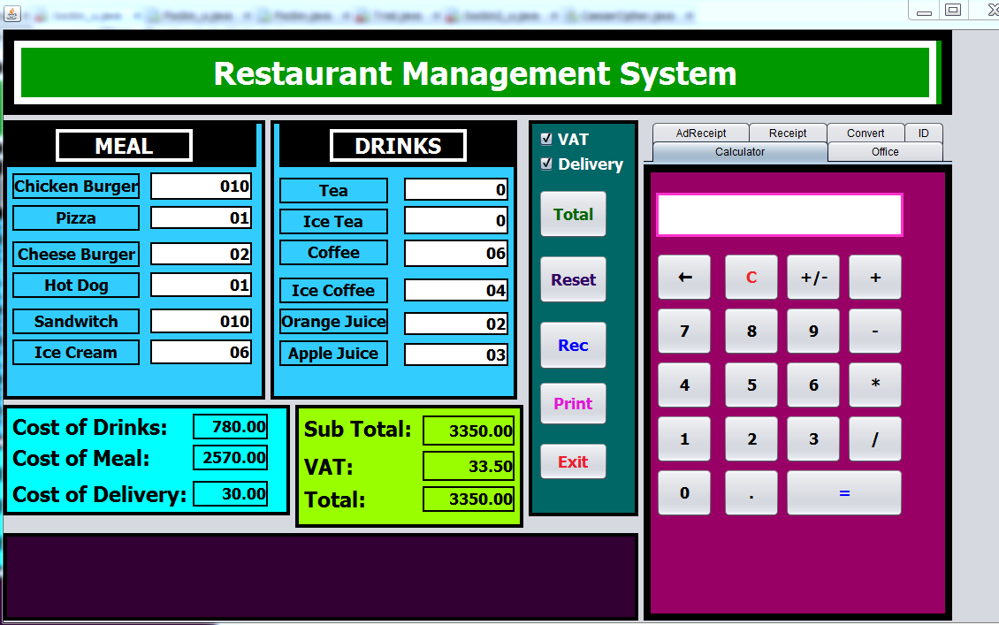
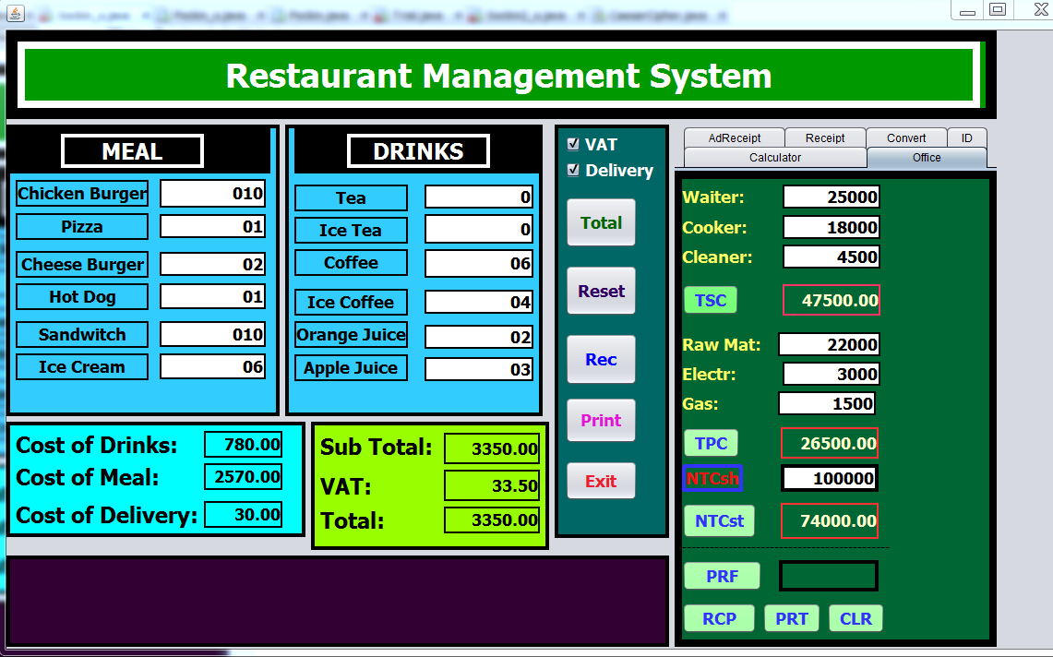
Overview of the Software (screenshots):
screenshot 7 screenshot 8

Slide 17
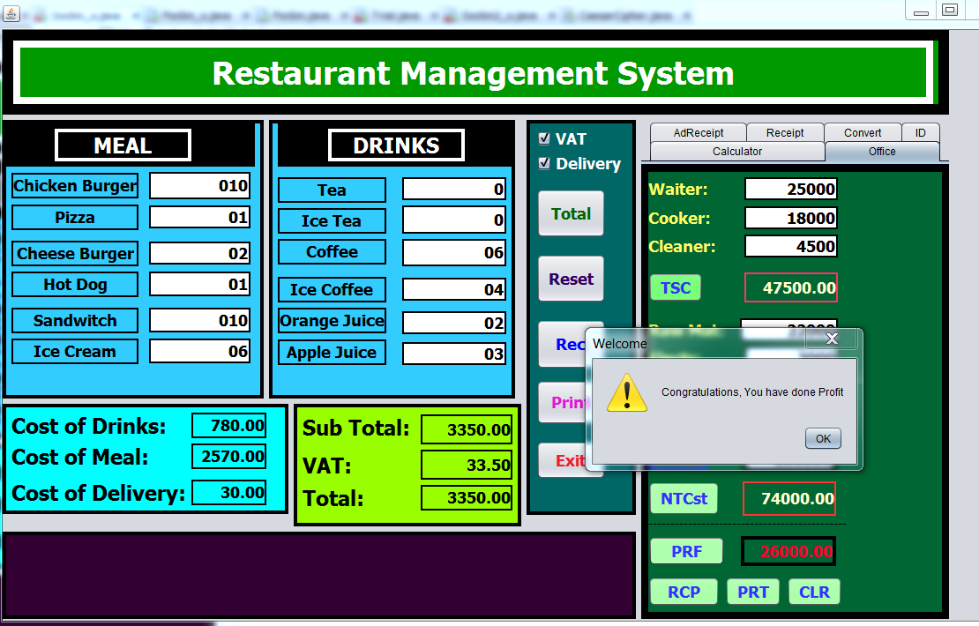
Overview of the Software (screenshots):
screenshot 9

Slide 18
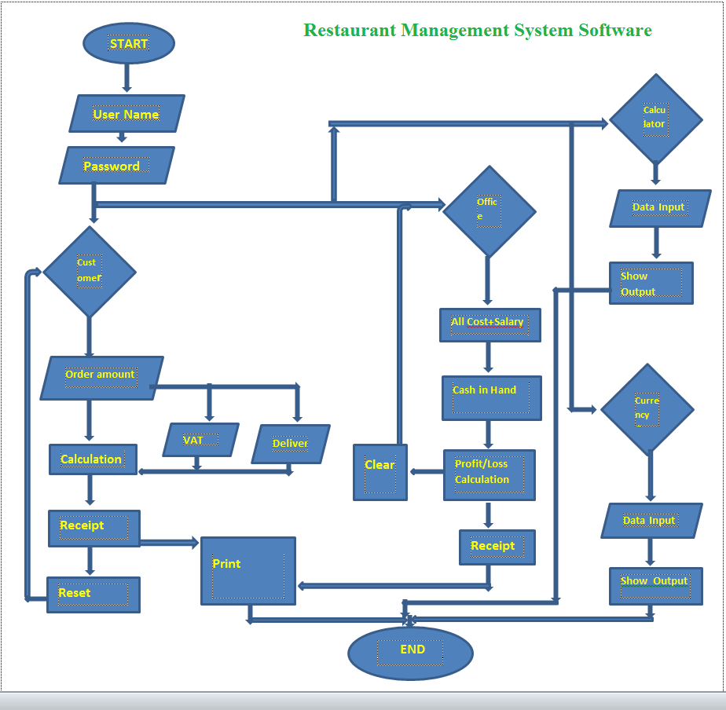
Flowchart :

Slide 19
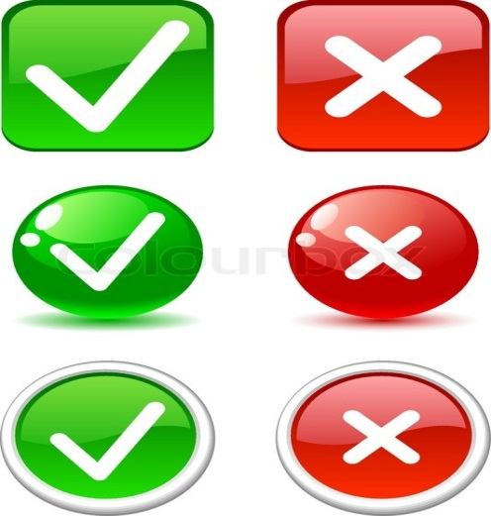
Data Validation :
The software project also has the feature of data validation. That means whenever you enter any illegal data specially type mistakes it denies to access these data and sound beep for entering the correct information until it receives the legal data.
Data validation mainly appears whenever we mistakenly enters unauthorized data value like number value in the sector of alphabetical value and alphabetical value in the sector of number value and so on.
FIG 18 : Data validation whether its correct or wrong.

Slide 20

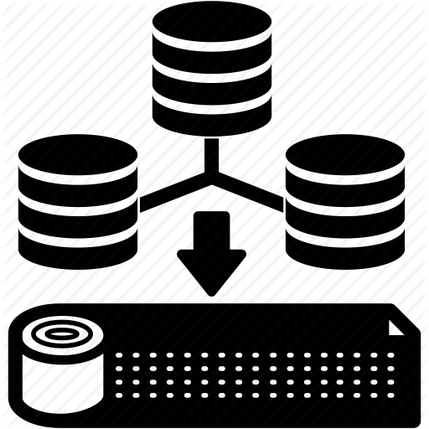
Limitations :
Though the project helps us calculating total bill and saves our time it has some limitations which are described below:
This software is unable to web connectivity so that it has the lacking whenever a restaurant has different branch in different place.
This software is unable to store a customer’s information in a file for future query.
The software is not build up as web connected so that someone can keep web contact through the software.
FIG 19: WEB connectivity Icon FIG 20: Storage Icon

Slide 21
Further Development (future work):
Our system has all the functionalities to manage a Restaurant Management process. But we have some plan to make it more efficient, reliable.
Our expectation is that in future we can make sure to add some important features i.e.:
(1) Nutritional Analysis aided interface in this software so that authority can easily get the nutritional information of their food item easily.
(2) Also, we expect to add the facility for storing customer’s data and information in a file for the purpose of later query.
(3) We also expect to add a web base interface in this software project so that different branch of a Restaurant can directly connect to the each other through Web by the help of this software project and can share each one’s updation in a specific moment.
(4) A feature of data analytic.

Slide 22

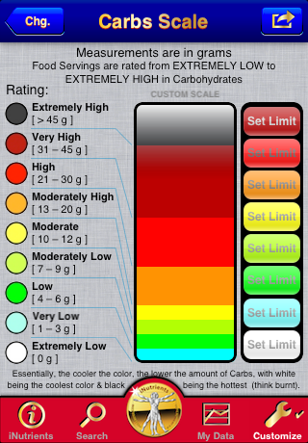
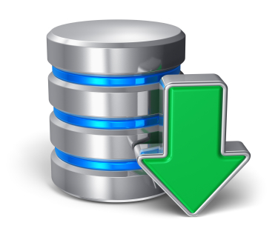

Further Development (future work):
FIG 21(a) : Nutrition Analysis FIG 21(b) : Nutrition Analysis
FIG 22: Data Storage FIG 23: Symbol for Web Connectivity

Slide 23
Result and Discussion :
We tried to develop the efficient and advance software for calculating the Bill of a customer, generating its receipt, printing out the receipt and also calculating the Restaurant owner’s profit-loss(included personnel salary, neat total cost etc. ) of a customer. Our system can successfully do calculations and data validations for the customer and also for the authority (owner). It has a very simplified and easy to use user interface. It is a GUI application and designed to support computer devices, it has different layout for devices having different screen sizes. It is kept secure with a username and default password. It has a nice and ordered architectural formation with structure and colour. It’s easily understandable and executable as we have implemented toolTip text at every point of the overall software. It can save enormous amount of time and energy of the necessary calculations and generation instead of providing manual receipt. Also, manual calculations are error prone which can be a great problem, but this system ensures error free, validation featured calculations. Reports can be generated in seconds and invoice is created dynamically. Besides the existing features and functionalities, it will be more advanced as we have lots of features planned for further development.

Slide 24

CONCLUSION :
THANK YOU, TO ALL.. ☺ ☺ ☺

